Slide 1

Spaceship Titanic
Predict which passengers are transported to an alternate dimension
Lorenzo Soricone
Claudia Lara Cordova
Victor Navarro Santos

Slide 2

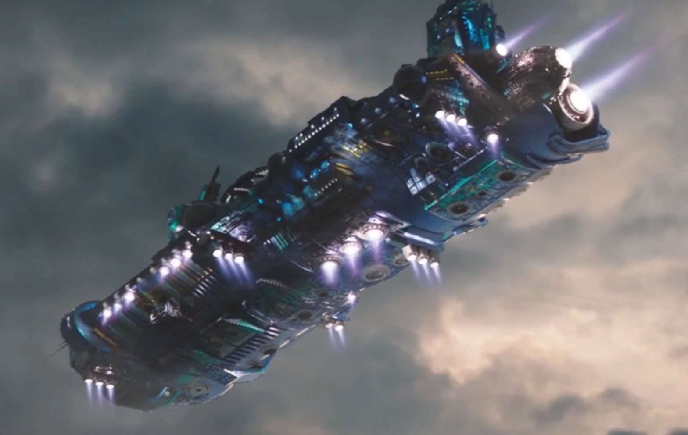
Welcome to the year 2912
This project aims to predict the survival of passengers on the fictional Spaceship Titanic using machine learning techniques. The dataset includes various features such as passenger demographics, spending patterns, and cabin information.
The goal is to build a robust model that can accurately classify whether a passenger was transported or not.

Slide 3


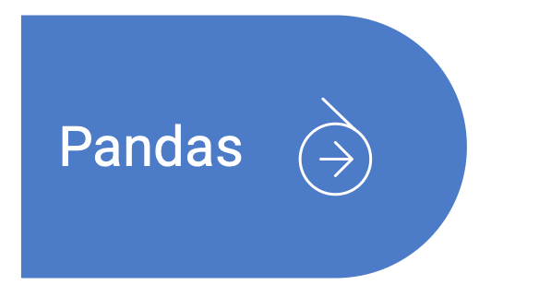
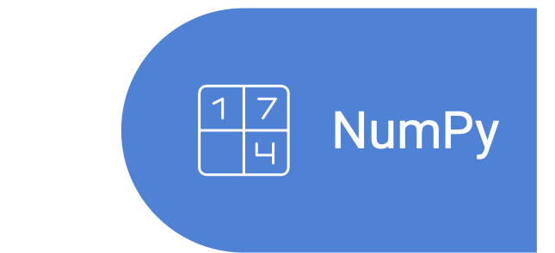
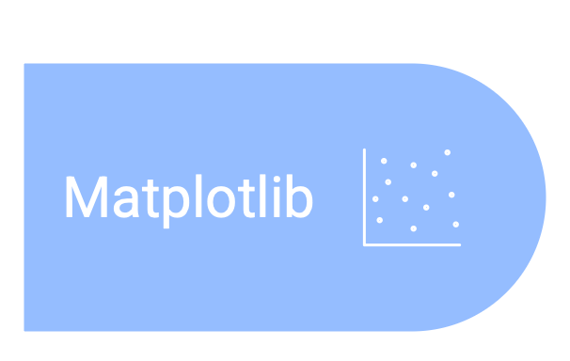
Tools
Programming language for data analysis
Library for data manipulation and analysis
Library for numerical computations in Python
Library for creating visualizations in Python

Slide 4
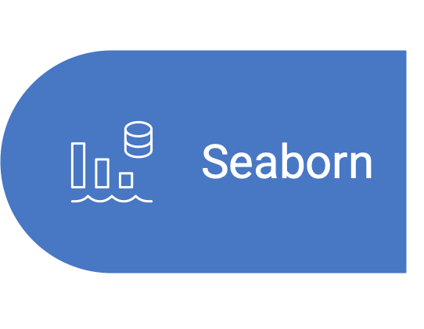
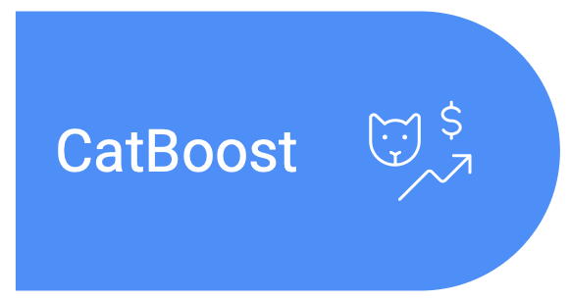
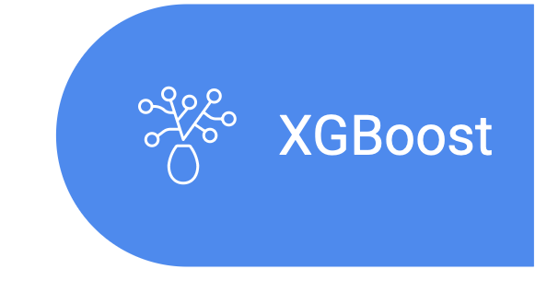

Tools
Data visualization library for creating plots.
Gradient boosting algorithm
Extreme gradient boosting
Efficient Python object serialization library

Slide 5
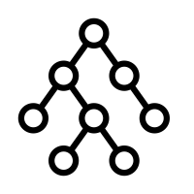
Directory Tree
src/
├── custom_transformers.py # Custom transformers for preprocessing
├── model_factory.py # Model creation, training and evaluation
├── preliminar_operations.py # Data loading and splitting
├── testing.py # Test prediction and submission generation
└── main.py # Execution script
data/
├── train.csv
├── test.csv
├── submission.csv # Final submission for Kaggle Competition
models/
└── best_model.joblib # Trained model

Slide 6

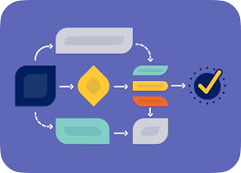
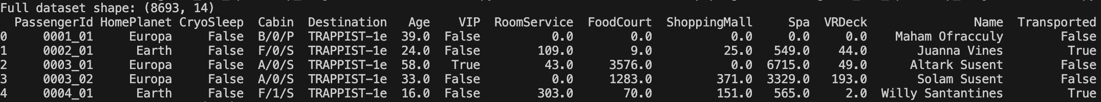
Data Analysis
Exploratory Data Analysis (EDA)
Analysis of features distributions
Spending pattern analysis
Features–Target Relationship Analysis
A data-set extract

Slide 7

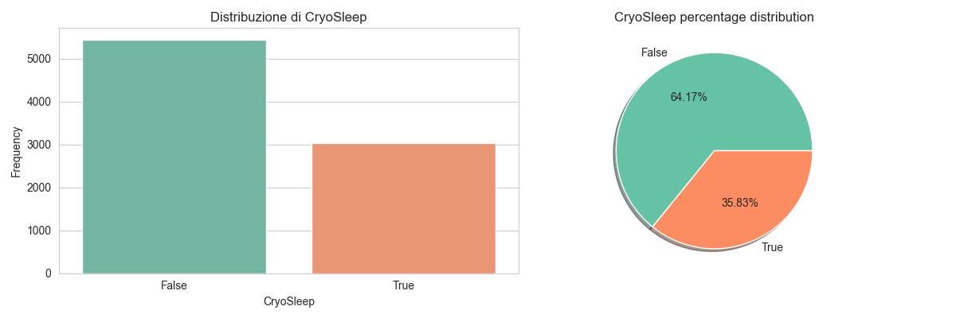
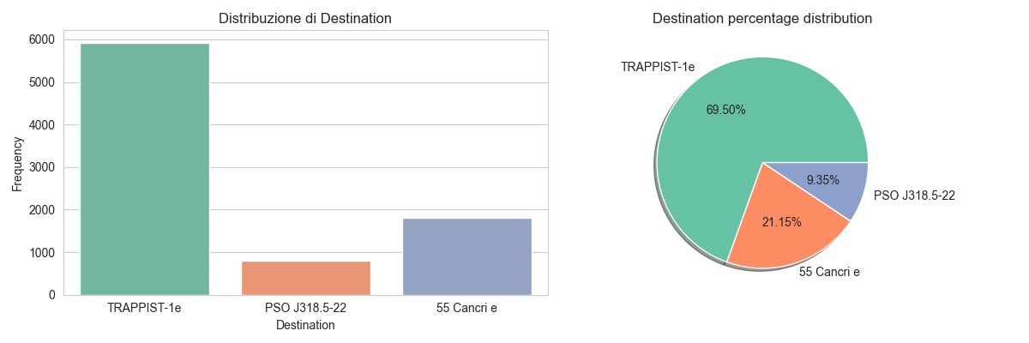
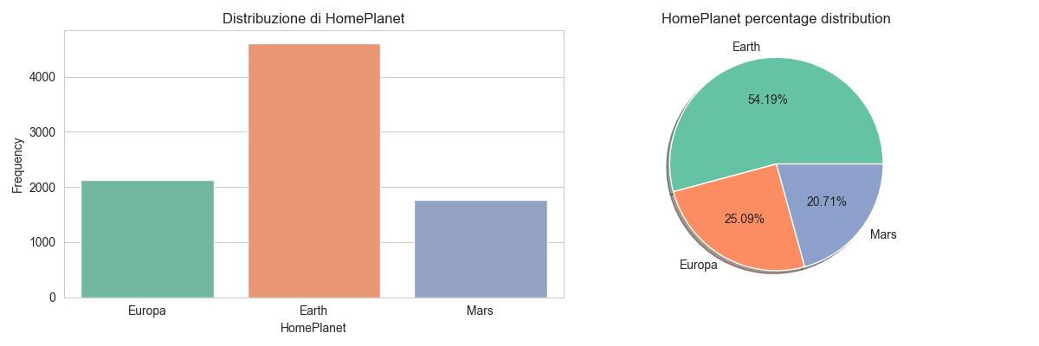
Distribution
Cryosleep distribution

Slide 8
Distribution
Destination distribution

Slide 9
Distribution
HomePlanet distribution

Slide 10
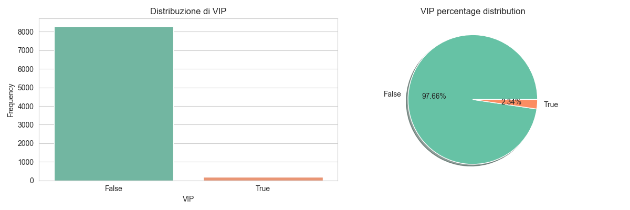
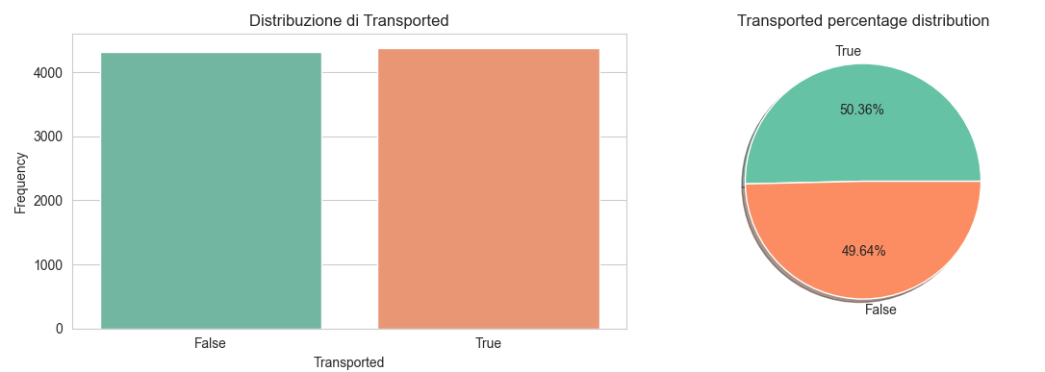
Distribution
VIP distribution
Transported distribution

Slide 11
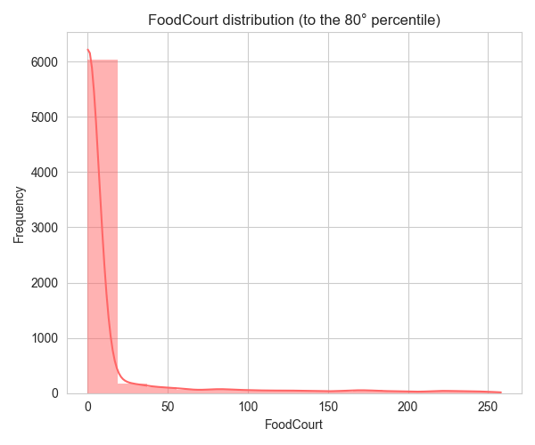
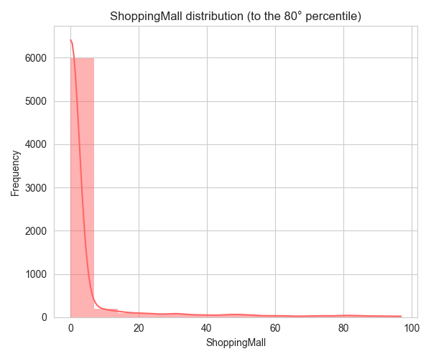
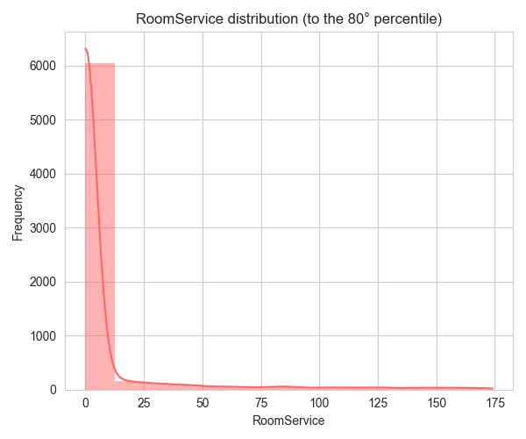
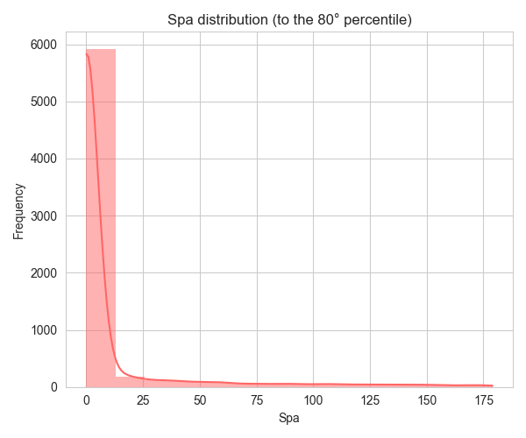
Distribution of Spending Categories
Most people spent very little
Standardization could be useful for scaling in linear models

Slide 12
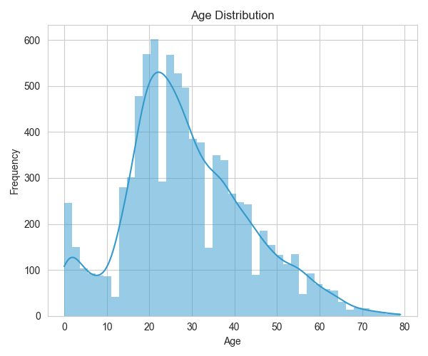
Age
distribution

Slide 13
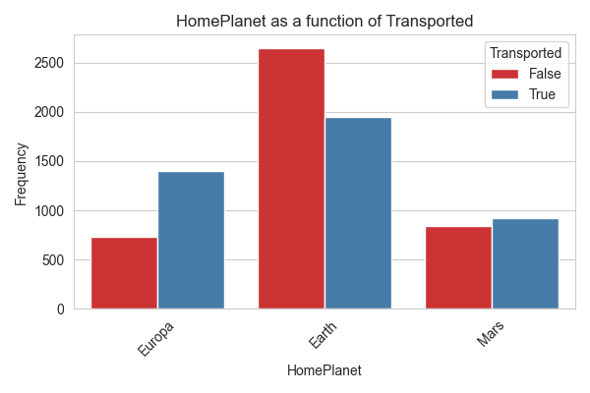
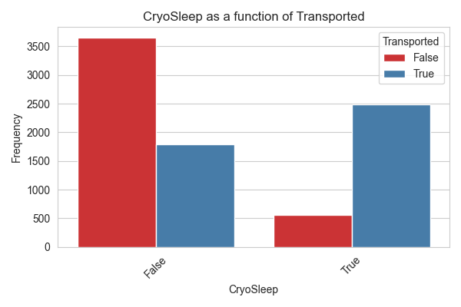
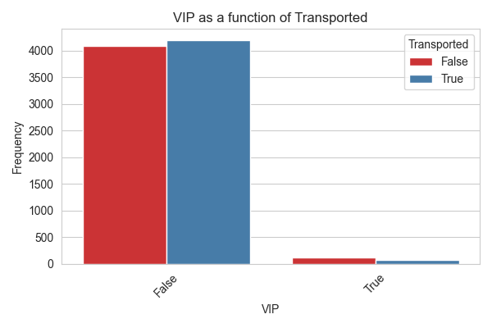
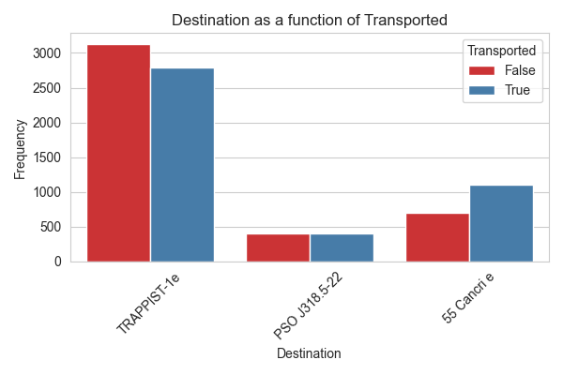

Slide 14
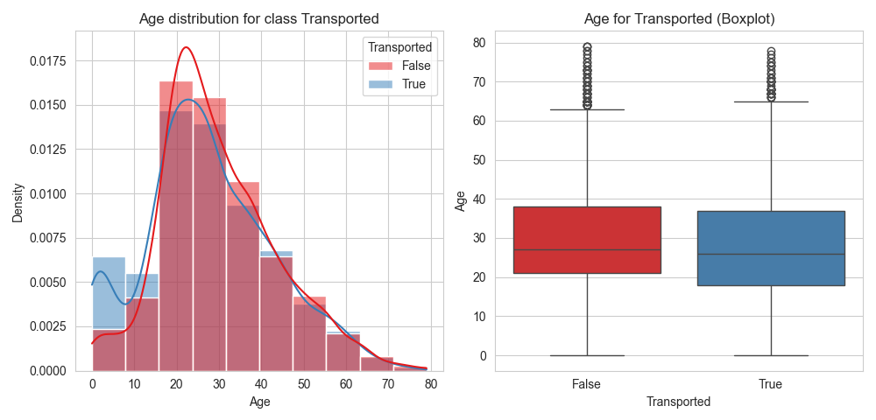
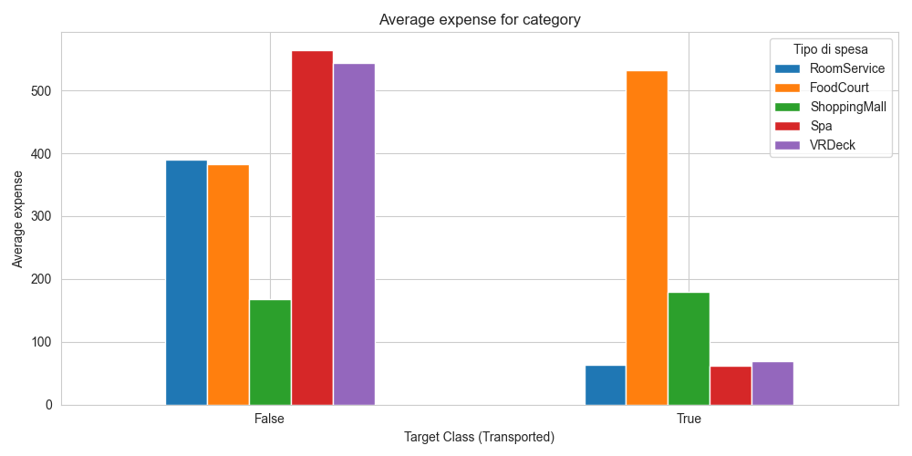
Age
distribution
for class
Expense for class Transported
Expense
for
class

Slide 15

Workflow
Prepocessor
Parameter grid/distributions
Pipeline
Model choice
Dataset
Holdout Split
Training set
GridSearchCV/RandomSearchCV
Best CV Accuracy
Best Parameters
Features importances
Test Set
Tuned model
Validation set
Submission.csv
Metrics Calculations
y-pred
y-train

Slide 16
Pipeline
Preprocessor (Data Preprocessing)
Creation of new features (Deck, Side, Grouped, FamilySize, TotalSpent)
Logical imputation based on family groups
Imputation of Cryosleep based on spending patterns
Classic preprocessing (KNNimputer/mean for numerical; mode for categorical)
Scaling of numerical features (normalization/standardization)
Encoding of categorical variables (OneHotEncoder)
Boolean to int of Cryosleep and VIP

Slide 17
Pipeline
Preprocessor (Data Preprocessing)
Creation of new features (Deck, Side, Grouped, FamilySize, TotalSpent)
Logical imputation based on family groups
Imputation of Cryosleep based on spending patterns
Classic preprocessing (KNNimputer/mean for numerical; mode for categorical)
Scaling of numerical features (normalization/standardization)
Encoding of categorical variables (OneHotEncoder)
Boolean to int of Cryosleep and VIP
3. Model Choices
Choices availabilities:
Random Forest
AdaBoost
SVM
XGBoost
CatBoost
Stacked Classifier

Slide 18


Final Steps
4. Metrics
Metrics calculated are:
Accuracy (CV, Val. , Train.)
Recall
Precision
Confusion Matrix
ROC Curve + AUC
5. Kaggle Submission
Final considerations
Genaration of file submission.csv
Submission on Kaggle and results visualization

Slide 19
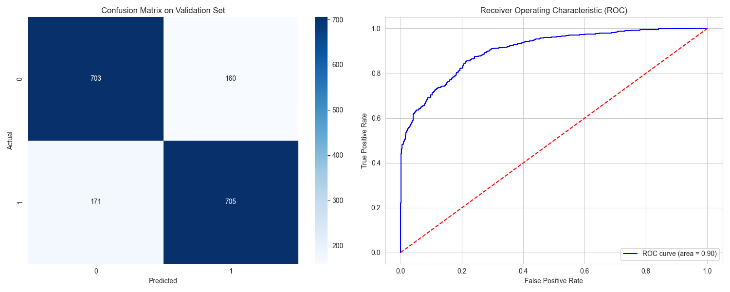
Random Forest

Slide 20
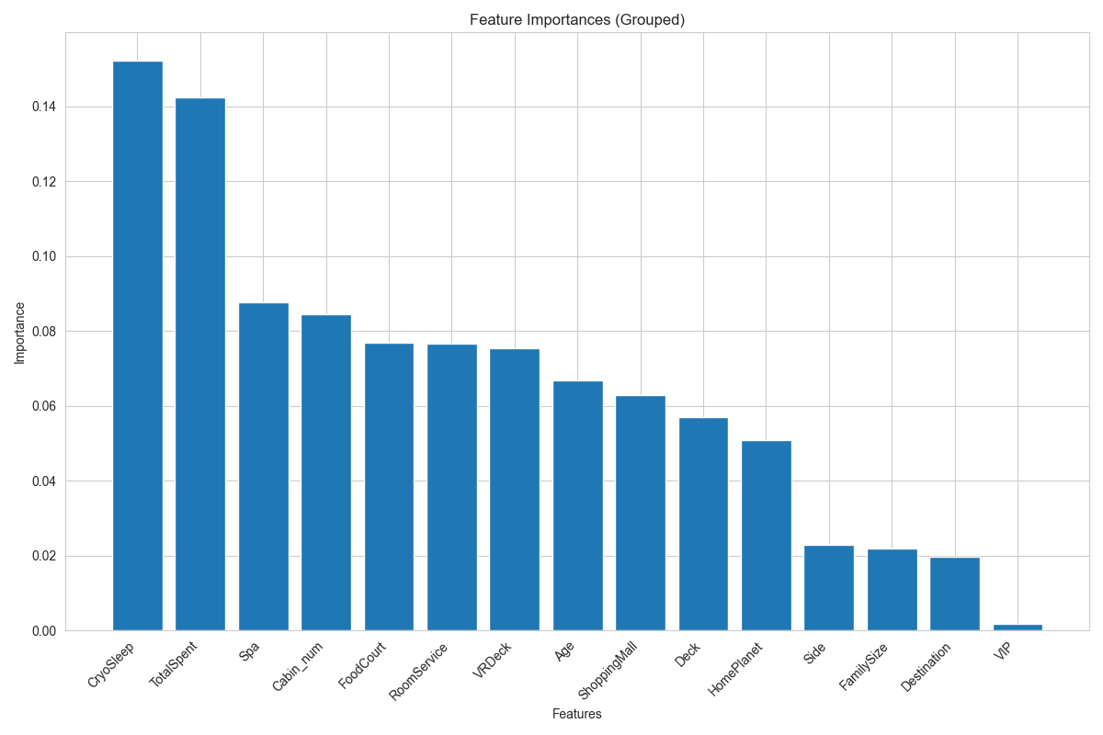
Random Forest
Best Parameters
Grid
Bootstrap | True
Max Depth | 15
Max Features | sqrt
Min Samples Leaf | 2
Min Samples Split | 5
N Estimators | 200
[True]
[5, 10, 15]
[sqrt, log2]
[2, 4, 6]
[5, 10]
[200, 300, 400]
Accuracies
Best CV Accuracy | 0.8056
Val. Accuracy | 0.8097
Tr. Accuracy | 0.9090
 | 0 | 1
Precision | 0.80 | 0.82
Recall | 0.81 | 0.80

Slide 21
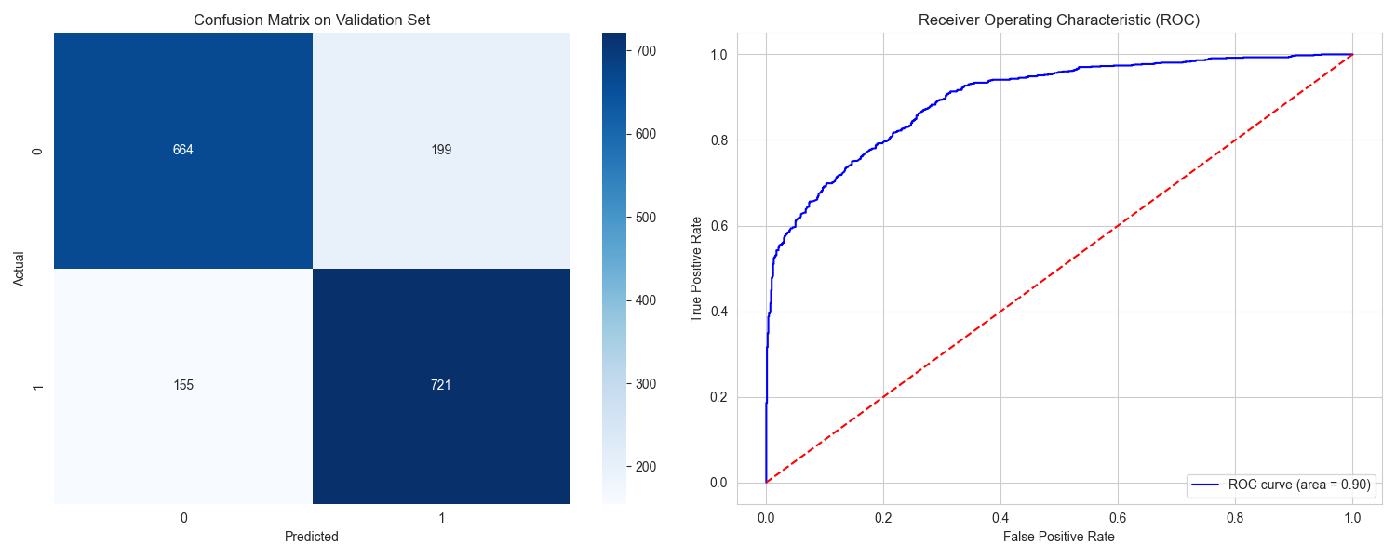
AdaBoost

Slide 22
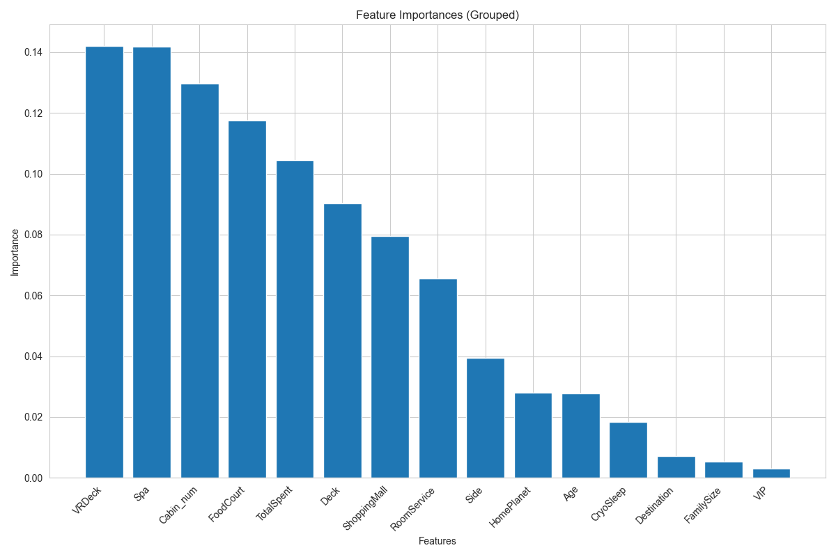
AdaBoost
Best Parameters
Grid
Base Estimator | Dec. Tree (Depth=3) | Dec. Tree (Depth = [1,2,3]
Learning Rate | 1.0 | [0.5, 1.0]
N Estimators | 300 | [100, 200, 300]
Accuracies
Best CV Accuracy | 0.8056
Val. Accuracy | 0.8097
Tr. Accuracy | 0.9090
 | 0 | 1
Precision | 0.81 | 0.78
Recall | 0.77 | 0.82

Slide 23

SVM

Slide 24
SVM
Best Parameters
Grid
C | 10 | [0.1, 1, 10, 100]
Gamma | scale | [scale, auto, 0.01, 0.1, 1.0]
Kernel | rbf | [linear, rbf]]
Accuracies
Best CV Accuracy | 0.8060
Val. Accuracy | 0.8045
Tr. Accuracy | 0.8394
 | 0 | 1
Precision | 0.80 | 0.81
Recall | 0.81 | 0.80

Slide 25

XGBoost

Slide 26
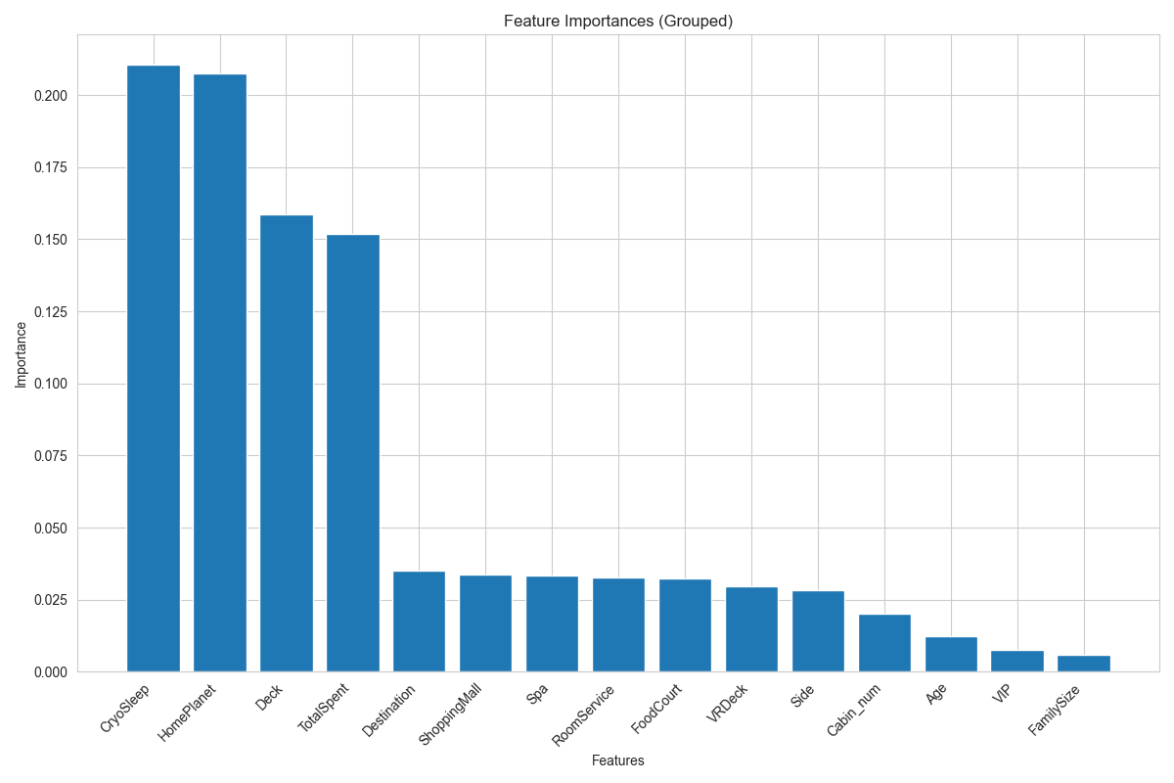
XGBoost
Best Parameters
Grid
Learning Rate | 0.05 | [0.05, 0.1, 0.2]
Max Depth | 4 | [3, 4, 6]
N Estimators | 300 | [100, 200, 300]
Susample | 1.0 | [0.8, 0.9, 1.0]
Accuracies
Best CV Accuracy | 0.8132
Val. Accuracy | 0.8097
Tr. Accuracy | 0.8506
 | 0 | 1
Precision | 0.82 | 0.80
Recall | 0.80 | 0.82

Slide 27

CatBoost

Slide 28
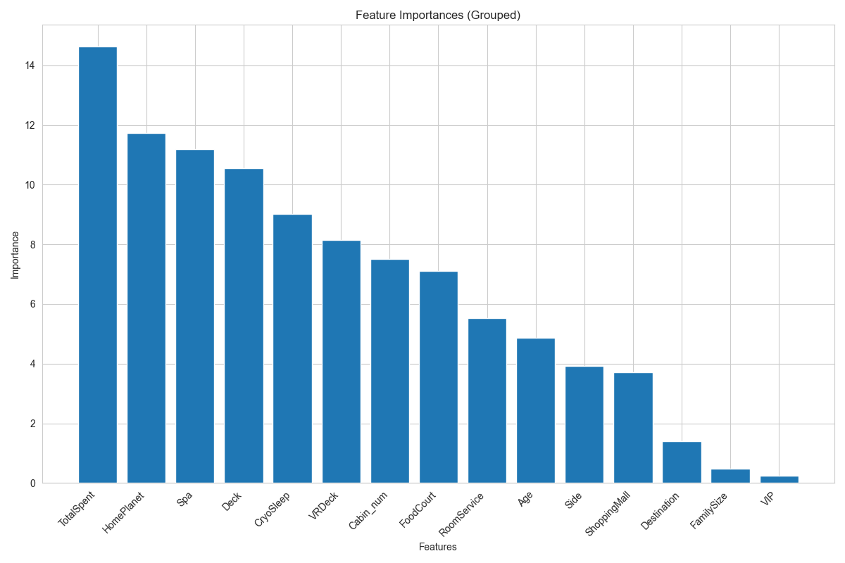
CatBoost
Best Parameters
RandomGrid
Random Strength | 2 | [0.5, 1, 2, 5]
Learning Rate | 0.02 | [0.02, 0.05, 0.07, 0.1, 0.15, 0.2]
12 Leaf Reg. | 3 | [1, 3, 5, 7, 9, 11]
Iterations | 1250 | [500, 750, 1000, 1250, 1500]
Depth | 4 | [4, 5, 6, 7, 8, 9, 10]
Border Count | 64 | [32, 64, 128, 254]
Bagging Temperature | 0.5
[0, 0.5, 1, 2]
Accuracies
Best CV Accuracy | 0.8141
Val. Accuracy | 0.8129
Tr. Accuracy | 0.8458
 | 0 | 1
Precision | 0.83 | 0.80
Recall | 0.78 | 0.84

Slide 29

Stacked Classifier

Slide 30
Stacked Classifier
Best Parameters | Grid
Final Estimator C | 1 | [0.1, 1, 10]
Accuracies
Best CV Accuracy | 0.8155
Val. Accuracy | 0.8097
Tr. Accuracy | 0.8631
 | 0 | 1
Precision | 0.83 | 0.79
Recall | 0.78 | 0.84

Slide 31

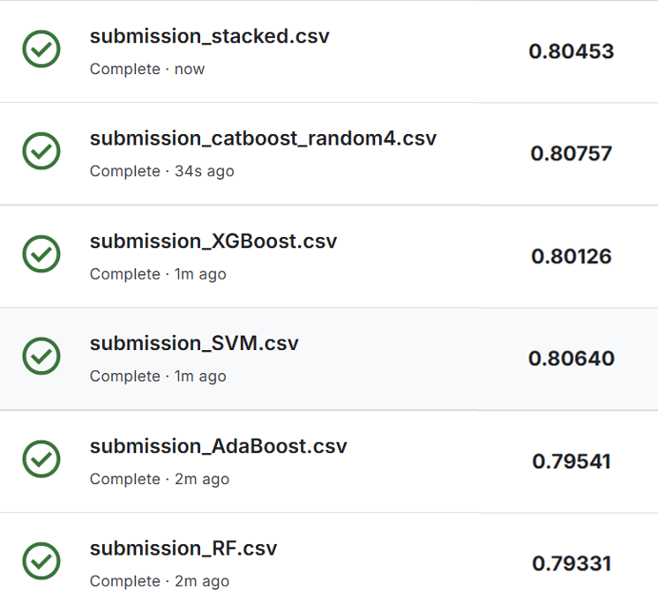


Classification
Thanks for your attention!

